Slide 1

Mathematical Modelling of Cervical Cancer With HPV Infection
Presented by:
Abhishek Pal (CSE/22002/856)
Aditya Vishwakarma (CSE/22006/860)
Amit Chausali (CSE/22012/866)
Arindam Mondal (CSE/22026/880)
Under the Supervision of Dr. Sudeshna Mondal
INDIAN INSTITUTE OF INFORMATION TECHNOLOGY,KALYANI

Slide 2









Mathematical Modelling of Cervical Cancer with HPV Infection
Introduction
Objectives
Model Structure
Mathematical Analysis
Bifurcation Analysis Sensitivity Analysis Result and Conclusion Future Direction References
1
6
7
8
9

Slide 3
Introduction
Cervical cancer is the fourth most common cancer among women globally
Over 600,000 new cases and 340,000 deaths reported annually More than 95% of cases attributed to HPV infection
Disease burden significantly higher in low and middle-income countries
Mathematical Modelling offers insights into disease dynamics and intervention strategies

Slide 4
Objective of the Project
Develop a compartmental mathematical model to understand the spread and control of HPV.
Analyze the progression from HPV infection to cervical cancer within the population.
Determine the conditions under which the disease persists or is eliminated.

Slide 5
Model Flowchart
βSI
1+α′I
Λ
δI
S
I
C
µS
αR
µI
(µ + ξ)C
γI
R
µR

Slide 6
Model Equations
SICR Model: Population divided into four compartments
S: Susceptible individuals
I: Infected individuals (with HPV)
C: Cancer individuals (with cervical cancer)
R: Recovered individuals (after HPV infection)
Total population: N (t) = S(t) + I(t) + C(t) + R(t)
dS
= Λ −
βSI
— µS + αR
dt
1 + α′I
dI βSI
= − γI − δI − µI dt 1 + α′I
dC
= δI − ξC − µC
dt
dR
= γI − αR − µR
dt

Slide 7
Description Of Parameters
Parameter | Description
Λ | Birth rate into the susceptible individuals
β | Transmission rate of contact with individuals
_{α}′ | Saturation factor
γ | Recovery rate due to natural immunity
δ | Progression rate of HPV to cervical cancer
ξ | Death rate of individuals with cervical cancer
µ | Natural rate of mortality
α | Rate of loss of immunity
Table 1: Model Parameters and Their Descriptions

Slide 8
Basic Reproduction Number (R₀)
The basic reproduction number R₀ tells you how many people one infected person can infect on average in a fully susceptible (healthy) population.
βS₀
R =
0
δ + γ + µ
If R₀ < 1: Disease-free equilibrium is stable, infection dies out.
If R₀ = 1: The disease is at the threshold; it may persist or die out depending on other factors (neutral stability).
If R₀ > 1: Endemic equilibrium emerges, infection persists in the population.

Slide 9
Equilibrium Points
Initial Condition: (S₀, I₀, C₀, R₀)
Disease-Free Equilibrium (DFE):
E₀ = (S∗, I∗, C∗, R∗) = (Λ/µ, 0, 0, 0)
Endemic Equilibrium (EE):
E₁ = (S∗, I∗, C∗, R∗) where:
(δ + γ + µ)(1 + α′I∗)
∗
S =
β
(Λβ − µ(δ + γ + µ))(α + µ)
I∗ =
β[(α + µ)(δ + γ + µ) − αδ] + α′µ(α + µ)(γ + δ + µ) δI∗
∗
C =
ξ + µ γI∗
∗
R =
α + µ

Slide 10
Stability Analysis: Disease-Free Equilibrium
Jacobian matrix eigenvalues at E₀:
λ₁ = −µ < 0
λ₂ = βΛ/µ − (δ + γ + µ) λ₃ = −(ξ + µ) < 0
λ₄ = −(α + µ) < 0
When R₀ < 1: All eigenvalues are negative ⇒ E₀ is locally stable

Slide 11
Time Series for Disease-Free Equilibrium
460
(a) Susceptible S(t)
30
(b) Infected I(t)
450
25
Susceptible (in m.)
440
Infected (in m.)
20
430
15
420
10
410
5
400
0
100 200 300 400
Time (years)
500
0
0
10
Time (years)
20
30
6
(c) Cervical Cancer C(t)
30
(d) Recovered R(t)
5
25
Cervical cancer (in m.)
Recovered (in m.)
4
20
3
15
2
10
1
5
0
0
20 40 60 80
Time (years)
100
0
0
20 40
60
80 100
Time (years)
Figure 1: Time series under disease-free equilibrium (R₀ < 1).

Slide 12
Stability Analysis: Endemic Equilibrium
The characteristic equation of J(E₁) is:
λ⁴ + a₁λ³ + a₂λ² + a₃λ + a₄ = 0
a₁ = −(a₁₁ + a₂₂ + a₃₃ + a₄₄),
a2 = (a33a44 + a11a44 + a11a22 − a12a21 + a11a33 + a22a44 + a22a33), a3 = −(a22a33a44 + a11a33a44 + a11a22a44 − a12a21a44 + a14a21a42
+ a11a22a33 − a12a21a33)
a4 = a11a22a33a44 − a12a21a33a44 + a14a21a33a42,
a = −
βI∗
1+α′I∗
— µ, a = −
βS∗
(1+α′I∗)²
, a₁₄ = α, a₂₁ =
βI∗
1+α′I∗
,
11
12
a =
βS∗
— (γ + δ + µ),
22
(1+α′I∗)²
a₃₂ = δ, a₃₃ = −(ζ + µ), a₄₂ = γ, a₄₄ = −(α + µ).

Slide 13
Stability Analysis: Endemic Equilibrium
We observe that if R₀ > 1, the following conditions (Routh-Hurwitz criterion) hold:
a₁ > 0,
a₃ > 0,
a₂ > 0,
a₄ > 0,
a₁a₂a₃ > a² + a²a₄.
3 1
Thus, all the roots of the characteristic equation have negative real
parts, implying that the endemic equilibrium is locally asymptotically stable when R₀ > 1.
Reference: Patil, A., 2021. Routh-Hurwitz criterion for stability: an overview and its implementation on characteristic equation vectors using MATLAB. Emerging Technologies in Data Mining and Information Security: Proceedings of IEMIS 2020, Volume 1, pp.319–329.

Slide 14
Time Series for Endemic Equilibrium
Endemic Equilibrium (Ro = 1.7402)
(a) Susceptible S(t)
500
80
(b) Infected with HPV I(t)
Susceptible population (in million)
450
Infected with HPV population (in million)
400
60
350
40
300
250
20
200
150
0
100
200
300
400
500
0
0
100
200
300
400
500
Time (years)
Time (years)
20
(c) Cervical cancer C(t)
350
(d) Recovered R(t)
Cervical cancer population (in million)
Recovered population (in million)
300
15
250
10
200
150
5
100
50
0
0
100
200
300
400
500
0
0
100
200
300
400
500
Time (years)
Time (years)
Figure 2: Time series under endemic equilibrium (R₀ > 1).

Slide 15
Bifurcation Analysis
Transcritical Bifurcation: A transcritical bifurcation is a local bifurcation in which the stability of two fixed points is exchanged as a parameter passes through a critical value. Specifically, two equilibrium points intersect and exchange their stability, meaning a stable fixed point becomes unstable and vice versa.
Occurs at R₀ = 1
Exchange of stability between disease-free and endemic equilibria For R₀ < 1: Only E₀ is stable
For R₀ > 1: E₁ becomes stable

Slide 16
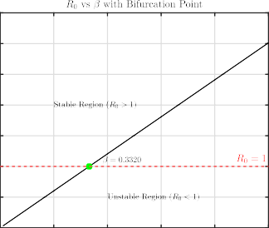
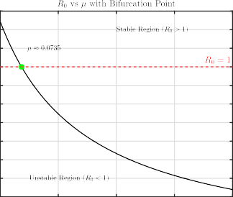
Bifurcation Analysis
Parameter values are taken from E₁.
3.5
1.3
3
1.2
1.1
2.5
1
2
0.9
0.8
1.5
0.7
1
0.6
0.5
0.5
0.4
0
0
0.2
0.4
0.6
0.8
1
0.3
0
0.2
0.4
0.6
0.8

Slide 17
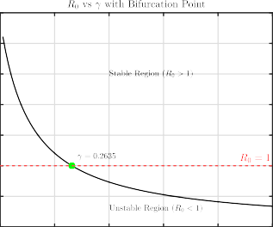
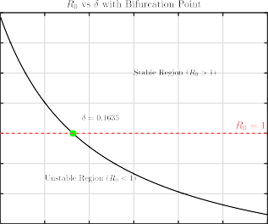
Bifurcation Analysis
3.5
1.8
3
1.6
2.5
1.4
2
1.2
1.5
1
1
0.8
0.5
0.6
0
0
0.2
0.4
0.6
0.8
1
0.4
0
0.1
0.2
0.3
0.4
0.5
0.6

Slide 18
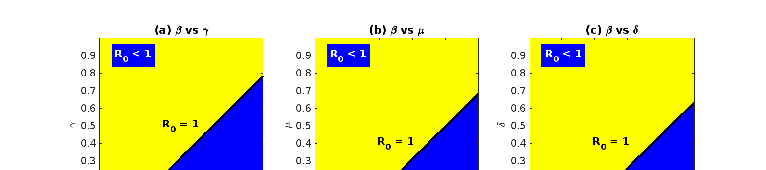
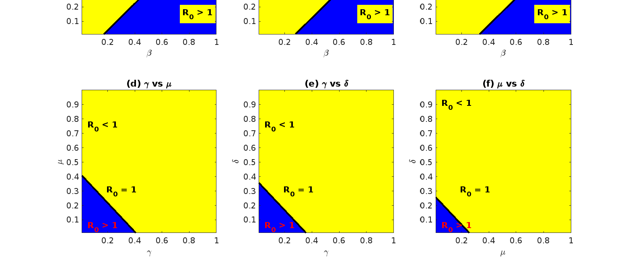
Stability regions for the disease-free and Endemic Eq.
Stability regions for β = 0.5, γ = 0.2, µ = 0.1, δ = 0.05, and S˜ = 0.9338

Slide 19
Local Sensitivity Analysis
Parameter | Sensitivity Index
β (Transmission rate) Λ (Recruitment rate) γ (Recovery rate) δ (Disease-induced death rate) µ (Natural death rate) | Υ^{β} = 1 R0 Υ^{Λ} = 1 _{γ} R0 Υ_{R0} = −0.90 Υ^{δ} = −0.036 R0 Υ^{µ} = −1.05 R0
Table 2: Sensitivity indices of R₀ with respect to model parameters

Slide 20
Local Sensitivity Analysis
2
1.5
1
0.5
0
-0.5
-1
-1.5
-2
Sensitivity Index
Parameters
Positive indices: Parameters that increase R₀ when increased. Negative indices: Parameters that decrease R₀ when increased.

Slide 21
Global Sensitivity Analysis
Parameter | Description | Values (year)⁻¹
Λ | Recruitment rate into the susceptible individuals | (5, 40)
β | Transmission rate of contact with individuals | (0.1, 1.0)
_{α}′ | Saturation factor | (0.005, 0.02)
γ | Recovery rate due to natural immunity | (0.01, 1.0)
δ | Progression rate of HPV to cervical cancer | (0.001, 0.6)
ξ | Death rate of individuals with cervical cancer | (0.1, 0.25)
µ | Natural rate of mortality | (0.01, 0.8)
α | Rate of loss of immunity | (0.01, 0.2)

Slide 22
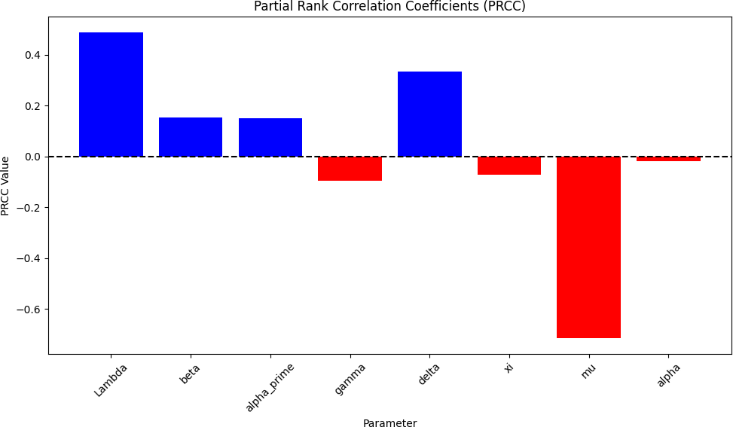
Partial Rank Correlation Coefficient

Slide 23
How to Reduce HPV Infection?
Reduce the Transmission Rate (β):
Introduce HPV vaccination to prevent the virus from spreading. School-based education on HPV prevention.
Increase the Recovery Rate (γ):
Early detection and treatment of HPV infections. Regular screening like Pap smear tests.
Promote healthy immunity via nutrition and wellness.
Limit Recruitment Rate (Λ): Vaccinate adolescents before exposure. Use targeted vaccination campaigns.
Delay Progression to Cancer (δ): Timely treatment to prevent cancer stage. Follow-up and regular medical checkups.

Slide 24
Key Results
Developed a compartmental model to study the spread and control of cervical cancer through HPV dynamics.
Found that if R₀ < 1, the disease dies out; if R₀ > 1, it persists and becomes endemic.
Numerical simulations confirm stability of disease-free and endemic equilibria based on parameter values.

Slide 25
Conclusion
Reducing transmission rate (β) through vaccination and awareness is key to controlling HPV spread.
Higher recovery rate (γ) leads to better disease outcomes and reduced cancer risk.
Mathematical models support targeted public health strategies for HPV prevention and treatment.

Slide 26
Future Work
Use deep learning to predict HPV infection trends from real-world epidemiological datasets.
Train neural networks to identify high-risk groups and optimize screening strategies.
Integrate real-time data for adaptive Modelling and intervention planning.

Slide 27
References
Rajan, P.K., Kuppusamy, M., Egbelowo, O.F. (2023). *A mathematical model for human papillomavirus and its impact on cervical cancer in India*. Journal of Applied Mathematics and Computing, 69, 753–770. https://doi.org/10.1007/s12190-022-01767-2
World Health Organization. *Global strategy to accelerate the elimination of cervical cancer as a public health problem* (2020). https://www.who.int/publications/i/item/9789240014107
Bruni, L. et al. *Human Papillomavirus and Related Diseases in India. Summary Report* (2018).
https://hpvcentre.net/
Sung, H. et al. *Global cancer statistics 2020: GLOBOCAN estimates of incidence and mortality worldwide for 36 cancers in 185 countries*. CA Cancer J. Clin. 71(3), 209–249 (2021). https://doi.org/10.3322/caac.21660
Patil, A. (2021). *Routh-Hurwitz criterion for stability: an overview and its implementation on characteristic equation vectors using MATLAB*. In: Emerging Technologies in Data Mining and Information Security: Proceedings of IEMIS 2020, Volume 1, pp. 319–329.

Slide 28
Thank you

Slide 29
?

